Slide 1
Human Activity Recognition
From Datasets to Demo
Sreela Kodali, August 10th
1 out of 22
Notes:
Good afternoon, my name is sreela, i’m one of the undergrad interns working here this summer. today i wanted to take this chance to share what i’ve been working on and what i’m really working towards.

Slide 2
2 out of 22
Notes:
Before I dive into what I’ve been working on,
Hypothetical Scenarios / Real world problems
- Police chief of minnesota
Resigned after unarmed shooting
Deployed body cameras
While this is undoubtedly an incredibly complicated problem with many different layers, are there other tools to
Effective ways to monitor and keep police officers accountable?
Suppose you have elderly parents that live alone. Or you have an assisted living facility where you have many residents.
B) Monitoring people in assisted living homes?
Suppose a patient is recovering from an injury or suffers from a long-term disease
C) How to check in on that person?

Slide 3
2 out of 22
Notes:
Before I dive into what I’ve been working on,
Hypothetical Scenarios / Real world problems
- Police chief of minnesota
Resigned after unarmed shooting
Deployed body cameras
While this is undoubtedly an incredibly complicated problem with many different layers, are there other tools to
Effective ways to monitor and keep police officers accountable?
Suppose you have elderly parents that live alone. Or you have an assisted living facility where you have many residents.
B) Monitoring people in assisted living homes?
Suppose a patient is recovering from an injury or suffers from a long-term disease
C) How to check in on that person?

Slide 4
2 out of 22
Notes:
Before I dive into what I’ve been working on,
Hypothetical Scenarios / Real world problems
- Police chief of minnesota
Resigned after unarmed shooting
Deployed body cameras
While this is undoubtedly an incredibly complicated problem with many different layers, are there other tools to
Effective ways to monitor and keep police officers accountable?
Suppose you have elderly parents that live alone. Or you have an assisted living facility where you have many residents.
B) Monitoring people in assisted living homes?
Suppose a patient is recovering from an injury or suffers from a long-term disease
C) How to check in on that person?

Slide 5
Human Activity Recognition (HAR)
Automatically detecting user’s action
Activities of Daily Living
Fitness
Physical conditions
3 out of 22
Notes:
the increasing prevalence of smartphones and wearables is making real-time data for these scenarios accessible. How can we interpret this data and make informed predictions?
Same way that gps has enabled a variety of applications – you can see where your friends are with find my friends, you can uber, google maps, etc.
Similiarly, HAR has can contribute to a myriad of fields
Police monitoring, wellness, fitness, dance, childcare, health
I’m fascinated because so many applications and interesting problem in such a resource constrained enviroment

Slide 6
Overview
Objective: Create system to detect human user’s activity
Intermediate steps:
Datasets
DL Models
Models2Chip
Demo
4 out of 22

Slide 7
1. Datasets
5 out of 22
Notes:
In order to create a model, needed to find a relevant dataset.

Slide 8
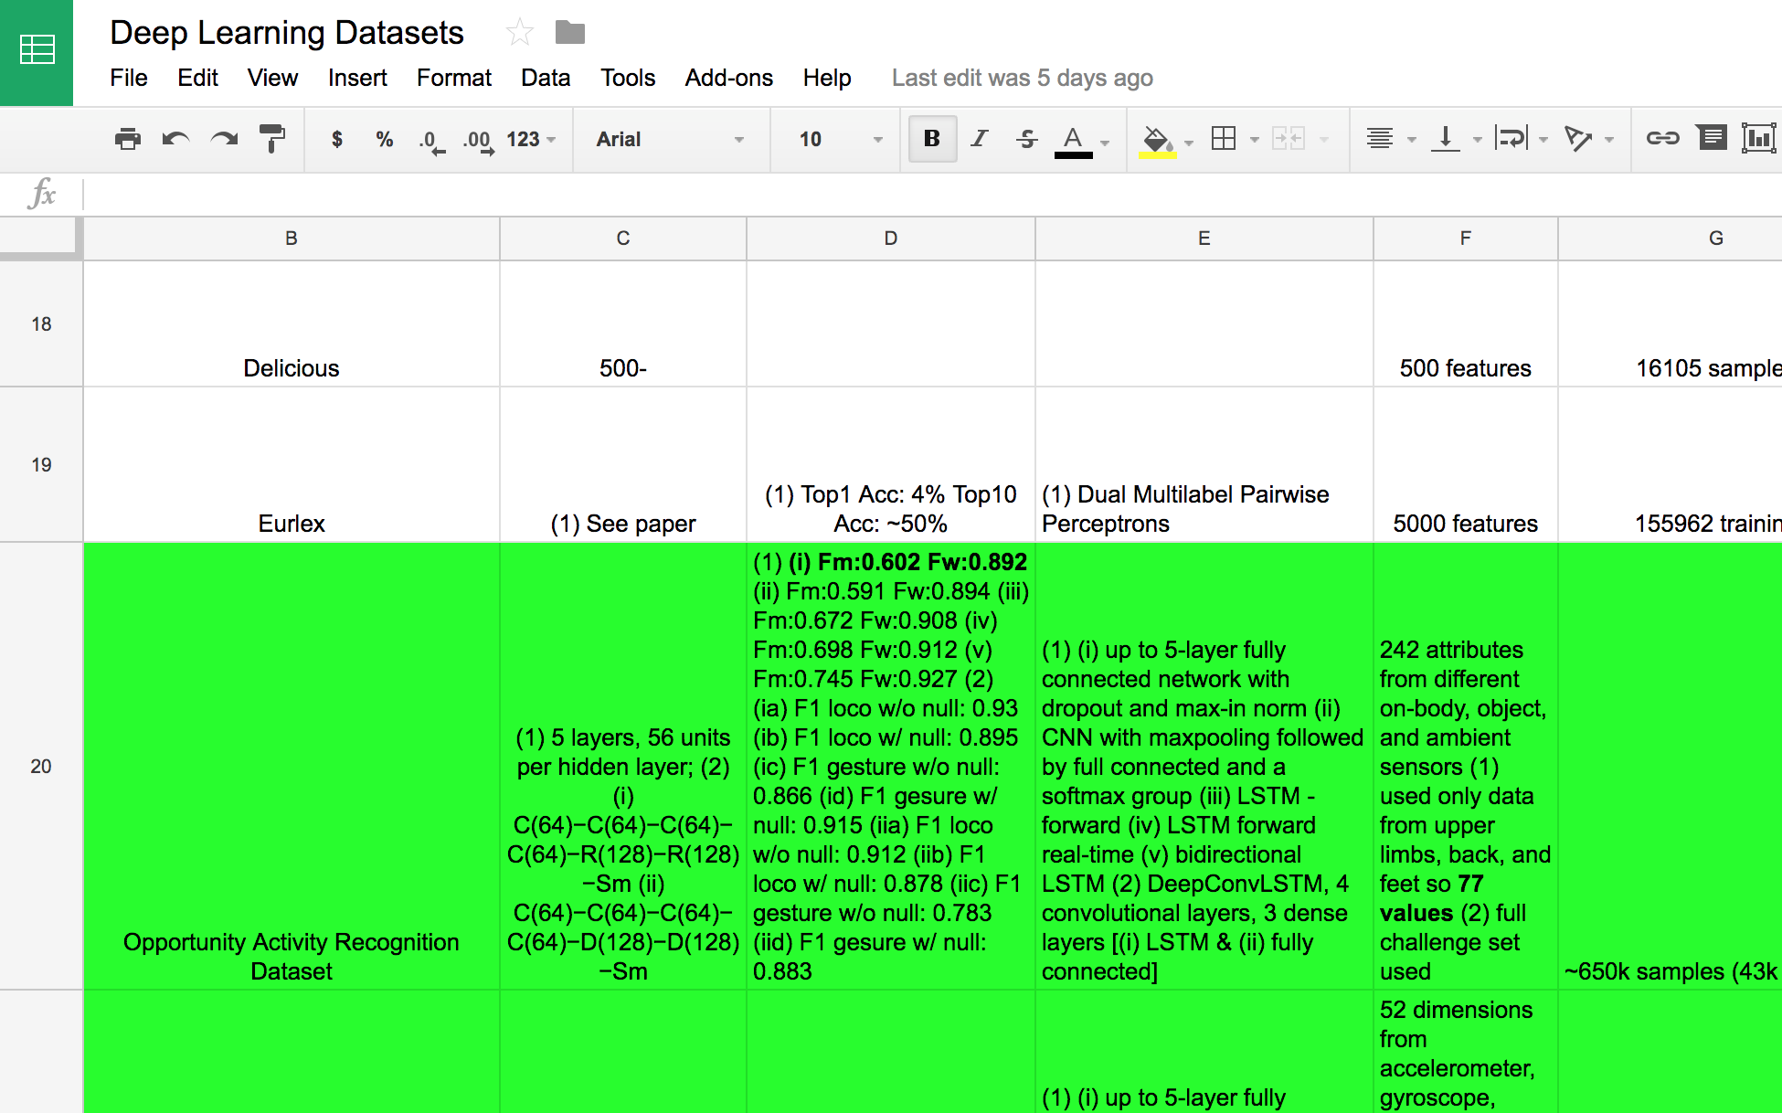
Voice
Vision
Text
HAR
Medical
6 out of 22
Notes:
First did thorough literature review on existing datasets, particularly HAR datasets.
Worked with Patrick to create an extensive spreadsheet on datasets, existing models for them, and if they had potential for sm2/sm3/smIV.
For example, found DNN for TIMIT (2000 inputs), HAR with chest mounted accelerometer data set, ADL for wrist-worn accelerometer, sports dataset, motion campture dataset, SKODA dataset, for different specific motion at an automobile facility, medical datasets – arrythmia, acute inflammations, thryoid
LINK: https://docs.google.com/spreadsheets/d/1ajeK8-pnzMp9eDHcoDGjyhsU60la29nnQOqTpVo7UBI/edit?usp=sharing

Slide 9
HAR Datasets: Overview
Dataset | Description | Sample Size | # of Samples | # of Classes | Sensors | Pre-processing
Opportunity | Activities of Daily Living | 77 | 650k | 18 | 7 IMUs | Window Segmentation
PAMAP2 | Activities of Daily Living | 52 | 473k | 13 | 3 IMUs and HR monitor | Window Segmentation
Daphnet-Gait | Detecting Freezing for Parkinson’s Patients | 9 | 470k | 3 | 3 Acceleration Sensors | Window Segmentation
Smartphone | Detecting basic physical activities | 6 | 35k | 13 | Accelerometer Gyroscope | Window Segmentation
7 out of 22
Notes:
After extensive research, isolated it to a few examples with potential

Slide 10
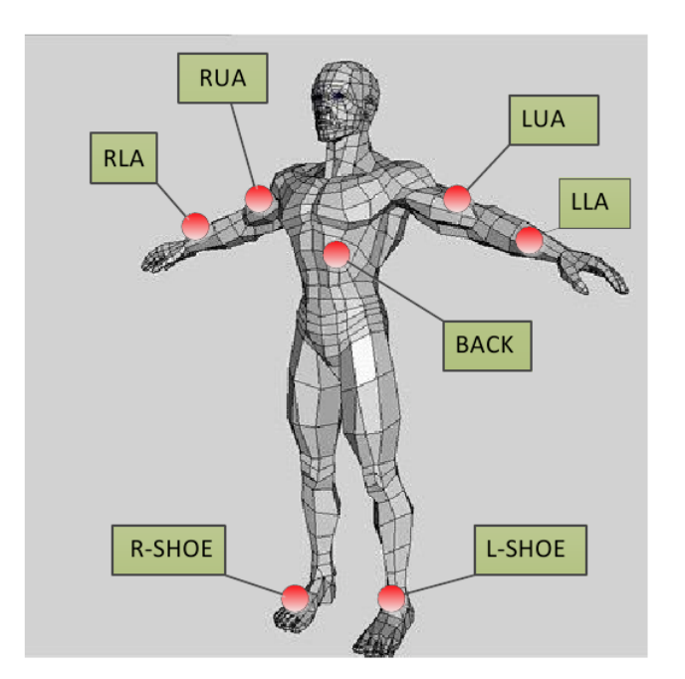
Opportunity
Dataset
1 Sample Size: 252 dimensions from on-body, object, and ambient sensors → 77 on-body dimensions selected for the model
No. of Samples: ~650k samples (43k frames)
Classes: 18 (17 mid-level gestures and other)
Sensors: 7 IMUs (back, shoes, upper/lower arm)
Existing Model
Size: 5-layer fully connected network with dropout and max-in norm
Performance: F_{m} - 0.575 F_{w} - 0.88
Input Dimension: 30 time points x 79 sensor features = 2370
Model Type: FC NN
8 out of 22
Notes:
Activities of Daily Living (Breakfast scenario)
OPPPORTUNITY
1 Other
2 Open Door 1
3 Open Door 2
4 Close Door 1
5 Close Door 2
6 Open Fridge
7 Close Fridge
8 Open Dishwasher
9 Close Dishwasher
10 Open Drawer 1
11 Close Drawer 1
12 Open Drawer 2
13 Close Drawer 2
14 Open Drawer 3
15 Close Drawer 3
16 Clean Table
17 Drink from Cup
18 Toggle Switch

Slide 11
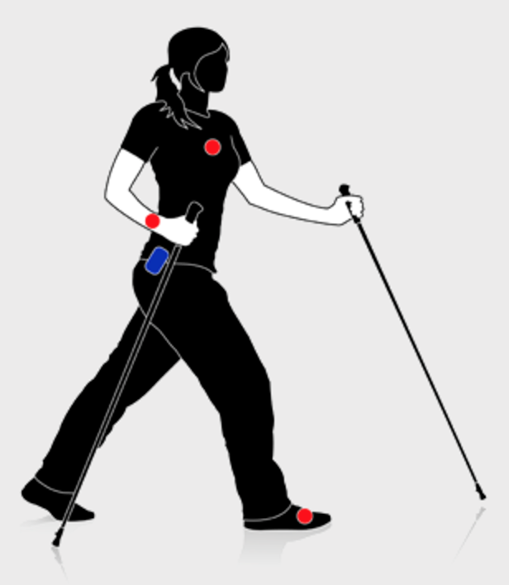
PAMAP2
Dataset
1 Sample Size: 52 dimensions from accelerometer, gyroscope, magnetometer, temperature and heart rate data of inertial measurement
No. of Samples: ~473k samples (14k frames)
Classes: 13 (12 activities and other)
Sensors: 3 Colibri wireless IMUs on of the dominant side, and 1 HR monitor
Existing Model
Size: 5-layer fully connected network with dropout and max-in norm
Performance: F_{m} - 0.904 F_{w} - 0.937
Input Dimension: 166 time points x 52 sensor features = 8632
Model Type: FC NN
9 out of 22
Notes:
Physical Activity Monitoring Data Set
The PAMAP2 Physical Activity Monitoring dataset contains data of 18 different physical activities (such as walking, cycling, playing soccer, etc.), performed by 9 subjects wearing 3 inertial measurement units and a heart rate monitor.
PAMAP
1 other
2 lying
3 sitting
4 sanding
5 walking
6 running
7 cycling
8 Nordic walking
9 ascending pairs
10 descending stairs
11 vacuum cleaning
12 ironing
13 rope jumping

Slide 12
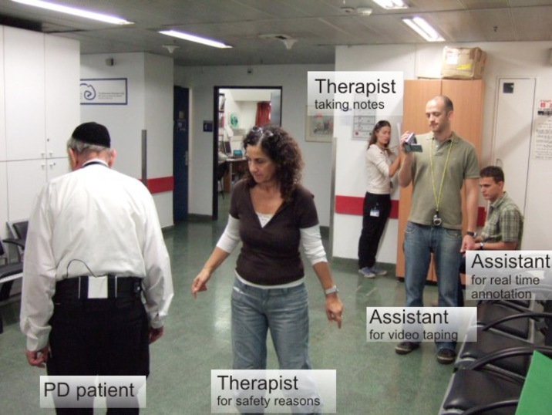
Daphnet Freezing of Gait
Dataset
1 Sample Size: 9 dimensions from accelerometer data on above the ankle, above the knee, and on the trunk
No. of Samples: ~470k samples (30k frames)
Classes: 3 (Freezing, No Freezing, Other)
Sensors: 3 acceleration sensors on above the ankle, above the knee, and on the trunk
Existing Model
Size: 5-layer fully connected network with dropout and max-in norm
Performance: F1 - 0.633
Input Dimension: 32 time points x 9 sensor features = 288
Model Type: FC NN
10 out of 22
Notes:
The Daphnet Freezing of Gait Dataset is a dataset devised to benchmark automatic methods to recognize gait freeze from wearable acceleration sensors placed on legs and hip.
Parkinson's disease (PD) is a long-term degenerative disorder of the central nervous system that mainly affects the motor system.^{[1]} The symptoms generally come on slowly over time.^{[1]} Early in the disease, the most obvious are shaking, rigidity, slowness of movement, and difficulty with walking.^{[1]}
The dataset was recorded in the lab with emphasis on generating many freeze events. Users performed there kinds of tasks: straight line walking, walking with numerous turns, and finally a more realistic activity of daily living (ADL) task, where users went into different rooms while fetching coffee, opening doors, etc. DG
1 other
2 no freeze
3 freeze

Slide 13
Smartphone-based HAR
Dataset
1 Sample Size: 3-axial linear acceleration and 3-axial angular velocity
No. of Samples: 10929
Classes: 13 (12 activities and other)
Sensors: Smartphone
Existing Model
Size: na
Performance: Precision: 89.3% R: 89.0%
Input Dimension: 516 feature vector
Model Type: Multi-class SVM
11 out of 22
Notes:
The experiments were carried out with a group of 30 volunteers within an age bracket of 19-48 years. They performed a protocol of activities composed of six basic activities: three static postures (standing, sitting, lying) and three dynamic activities (walking, walking downstairs and walking upstairs). The experiment also included postural transitions that occurred between the static postures.
UCI Smartphone
1 Other
2 WALKING
3 WALKING_UPSTAIRS
4 WALKING_DOWNSTAIRS
5 SITTING
6 STANDING
7 LAYING
8 STAND_TO_SIT
9 SIT_TO_STAND
10 SIT_TO_LIE
11 LIE_TO_SIT
12 STAND_TO_LIE
13 LIE_TO_STAND

Slide 14
2. DL Models
12 out of 22
Notes:
Next step was to set up dnn models with these datasets. However first step was to find all these datasets and ensure they were in a usable format.

Slide 15
Preprocessing
Hdf5 format
Missing value handling
Rescaling
Window Size
Overlap
13 out of 22
Notes:
Finding all these directories, extracting them, splitting them into training, testing, and validation, replacing nans, 32/-32 range
Painstakingly tinkered with different window sizes, overlap percentages, hidden dimensions, and layers to create models

Slide 16
DL Models Summary
Dataset | Input Size | Output Size | Hidden Dim | Model Size | Mean F-score | Weighted F-score | Test Accuracy
Opportunity | 924 | 18 | 56-56-56 | 0.998 MB | 0.602 | 0.892 | 89.65%
PAMAP2 | 936 | 13 | 55-55-55 | 0.984 MB | 0.608 | 0.657 | 67.86%
Daphnet-Gait | 144 | 3 | 112-112-112 | 0.873 MB | 0.617 | 0.711 | 71.90%
Smartphone (Raw) | 384 | 13 | 72-72-72 | 0.711 MB | 0.682 | 0.791 | 79.52%
Smartphone (Feature Extracted) | 561 | 12 | 70-70-70 | 0.882 MB | 0.804 | 0.927 | 92.79%
14 out of 22

Slide 17
3. Models2Chip
15 out of 22
Notes:
Before I dive into what I’ve been working on,
Hypothetical Scenarios / Real world problems
Effective ways to monitor and keep police officers accountable?
Monitoring patients in assisted living homes?
How to get help in a dangerous situation? i.e. SA?

Slide 18
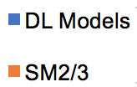
16 out of 22
Notes:
Port models.
Ran into bugs at first, rescaled the data, loading the weights properly

Slide 19
4. Demo
17 out of 22

Slide 20
HAR with Smartphone
SM2/3
Walking
Preprocessing
Program
iOS Application
18 out of 22

Slide 21
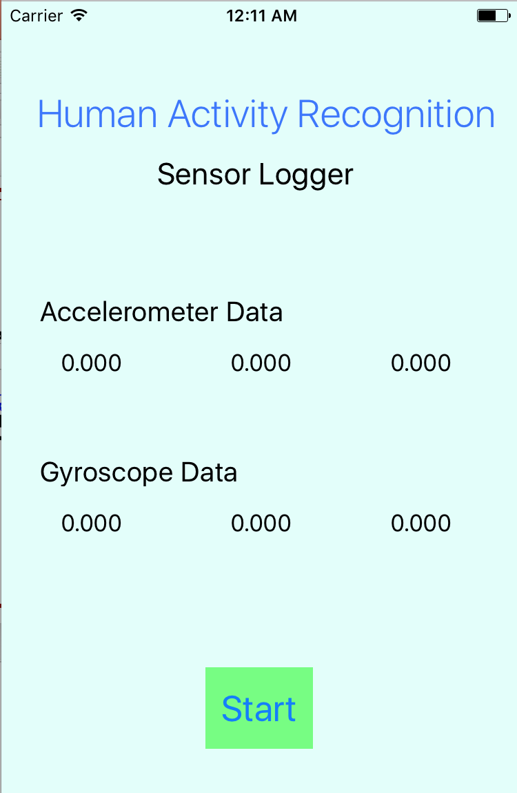
iOS Application
19 out of 22

Slide 22
Preprocessing Program
Finds raw data file and preprocesses
Generates files for SM2/3
Runs new test examples on chip and outputs activity class
User-friendly Interface
Plotting feature
20 out of 22

Slide 23
Next Steps
SM2/3
Walking
Preprocessing
Program
iOS Application
21 out of 22

Slide 24
Next Steps
SM2/3
Walking
Preprocessing
Program
iOS Application
21 out of 22

Slide 25
Future Work
Improving preprocessing and performance
Hardware setups for other datasets
Real-time system
Thesis
22 out of 22

Slide 26
Additional Slides

Slide 27
Preprocessing: Window Segmentation
Dataset | Window Size | Overlap
Opportunity | 12 samples (0.36 s) | 50%
PAMAP2 | 18 samples (0.56 s) | -10%
Daphnet-Gait | 16 samples (0.48 s) | 50%
Smartphone (Raw) | 64 samples (1.28 s) | 50%
Smartphone (Feature Extracted) | 128 samples (2.56 s) | 50%

Slide 28
DL Models Performance Variables
Window size
Overlap
Hidden Layer(s) Size
Number of Layers
14 out of 28

Slide 29
Opportunity
Model Overview
Topology: 5-layer fully connected network with 56 units each hidden dimension
Size: 0.998 MB
Input Dimension: 12 time points x 77 sensor features = 924
Model Type: FC NN
Preprocessing
Selecting sensors with no connection dropping; For frame analysis, sliding windows of duration 0.4 second and 50% overlap
Performance
Test Accuracy: 89.65%
F-score: F_{m} - 0.602 F_{w} – 0.892
Most identifiable activities: Open door 2, Close Door 2, Open Fridge, Open Drawer 3, Toggle Switch

Slide 30
PAMAP2
Model Overview
Topology: 5-layer fully connected network with 55 units each hidden dimension
Size: 0.984 MB
Input Dimension: 18 time points x 52 sensor features = 936
Model Type: FC NN
Preprocessing
Downsampled the accelerometer data to 33.3Hz; Non-overlapping sliding windows of 0.96 seconds duration with ~0.1 second stepping between adjacent windows; Linear interpolation for missing values
Performance
Test Accuracy: 67.86%
F-score: F_{m} - 0.608 F_{w} - 0.657
Most identifiable activities: Lying, Sitting, Running, Cycling, Nordic Walking, Ironing

Slide 31
Daphnet of Freezing Gait
Model Overview
Topology: 5-layer fully connected network with 112 units each hidden dimension
Size: 0.873 MB
Input Dimension: 16 time points x 9 sensor features = 144
Model Type: FC NN
Preprocessing
Downsampled the accelerometer data to 32Hz; For frame-by frame analysis, sliding windows of 0.5 second duration and 50% overlap
Performance
Test Accuracy: 71.90%
F-score: F_{m} - 0.617 F_{w} – 0.711
Most identifiable activities: n/a

Slide 32
Smartphone-based HAR: Raw Data
Model Overview
Topology: 5-layer fully connected network with 72 units each hidden dimension
Size: 0.711 MB
Input Dimension: 64 time points x 6 sensor features = 384
Model Type: FC NN
Preprocessing
For frame-by frame analysis, fixed-width sliding windows of 1.28 sec and 50% overlap (64 readings/window)
Performance
Test Accuracy: 79.52%
F-score: F_{m} - 0.682 F_{w} - 0.791
Most identifiable activities: Walking, Walking Upstairs, Walking Downstairs, Sitting, Laying

Slide 33
Smartphone-based HAR: Feature Extracted Data
Model Overview
Topology: 5-layer fully connected network with 70 units each hidden dimension
Size: 0.882 MB
Input Dimension: 561 feature extracted vector
Model Type: FC NN
Preprocessing
(1) noise filters (2) fixed-width sliding windows of 2.56 sec and 50% overlap (128 readings/window) (3) acceleration signal separated with a Butterworth low-pass filter into body acceleration and gravity (4) range of calculations for feature extraction Performance
Test Accuracy: 92.79%
F-score: F_{m} - 0.804 F_{w} - 0.927
Most identifiable activities: Walking, Walking Upstairs, Walking Downstairs, Standing, Laying

